Slide 1
Database System

Slide 2
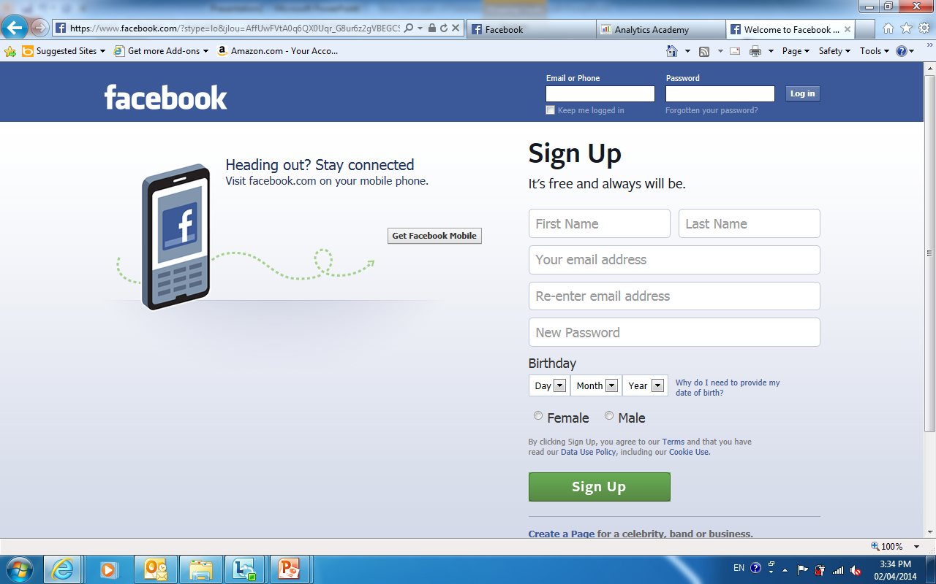
Facebook
Notes:
Question:
How does Facebook knows who are you?
How does Facebook stores the information?

Slide 3
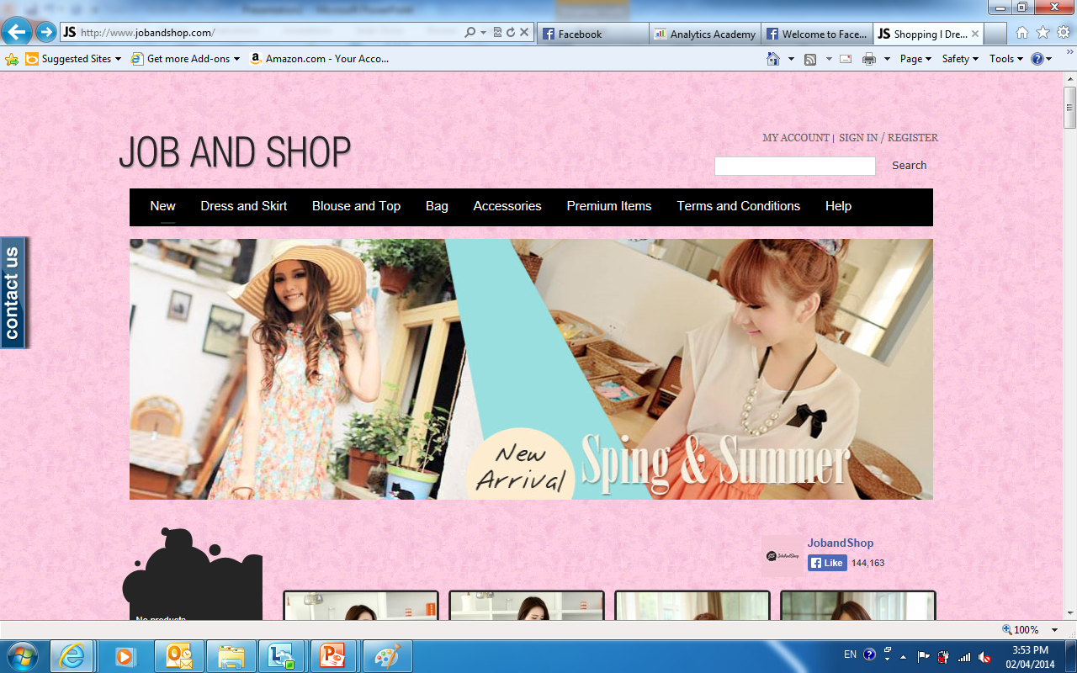
Website
Notes:
Click on Register on top right corner
Create an account (key in abc@hotmail.com)

Slide 4
Databases and Database Management Systems
Why use databases?
Database
A collection of inter-related data

Slide 5

Basic Concepts of A Database System
What are Database Management Systems?
Database Management System (DBMS)
A collection of programs used to
Manage (create, update or delete),
Protect, and,
Control the access of
the data in a database
Commonly known relational DBMSs are Oracle, MS SQL and DB2

Slide 6
Basic Concepts of A Database System
A database management system (DBMS) is computer software designed for the purpose of managing databases based on a variety of data models.

Slide 7
Relational Model

Slide 8

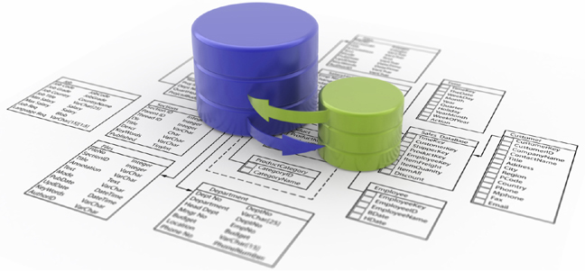

#1: Name of Relation is unique in a database
Customer
Customer
# 1: You cannot create another relation/table
in the same database by the same name

Slide 9

#2: Every cell must be single-valued
Title | First_Name | Last_Name | Email | Password | DOB
Ms | Linda | See | LindaS@hotmail.com Lsoh@gmail.com LindaSoh@gmail.com | Abc123 | NULL
Mr | David | Lee | DavidL@gmail.com | Da12lee | 13/09/1997
Ms | Linda | Soh | LSoh@hotmail.com | Abc123 | 20/12/1998
Customer
# 2: You cannot have multi-valued cell

Slide 10
#3: Attribute name in a relation must be unique
Title | Name | Name | Email | Password | DOB
Ms | Linda | See | LindaS@hotmail.com | Abc123 | NULL
Mr | David | Lee | DavidL@gmail.com | Da12lee | 13/09/1997
Ms | Linda | Soh | LSoh@hotmail.com | Abc123 | 20/12/1998
Customer
# 3: You cannot have two attributes
by the same name

Slide 11


#4: Each tuple in a relation is unique
(Primary Key)
Title | First_Name | Last_Name | Email | Password | DOB
Mdm | Linda | See | LindaS@hotmail.com | Abc123 | NULL
Mr | David | Lee | DavidL@gmail.com | Da12lee | 13/09/1997
Ms | Linda | Soh | LSoh@hotmail.com | Abc123 | 20/12/1998
Ms | Linda | Soh | LSoh@hotmail.com | Abc123 | 20/12/1998
Customer
Defining primary key will ensure that every tuple is unique !!
# 6: You cannot have duplicate
Tuple/row !!

Slide 12
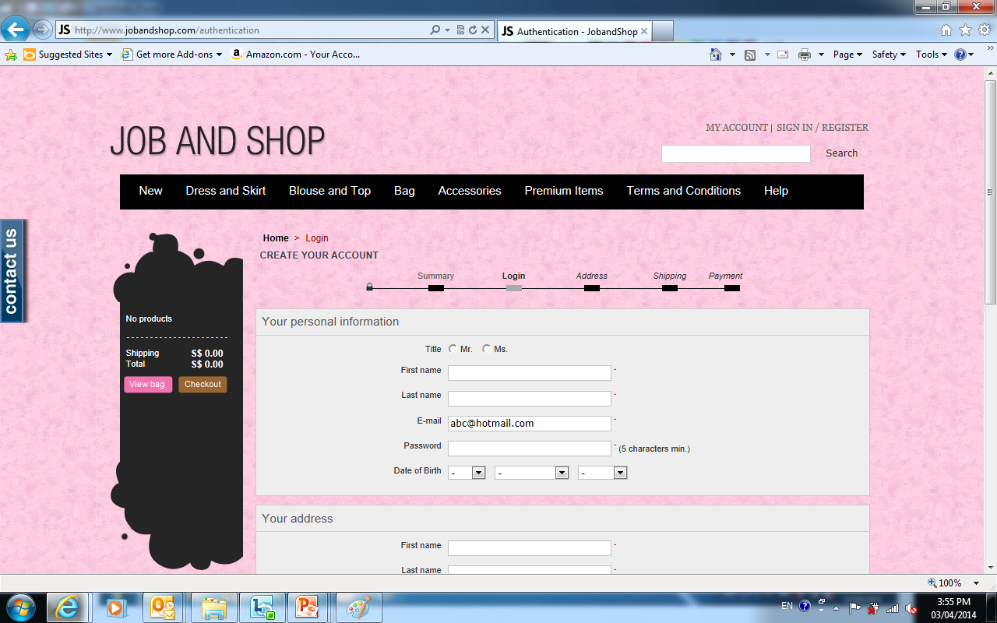
Website Data

Slide 13
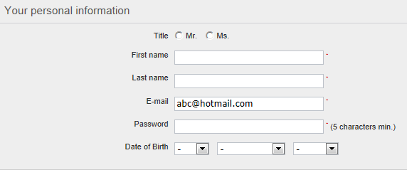
Relation
Title | First_name | Last_name | Email | Password | DOB
Ms | Linda | See | LindaS@hotmail.com | Abc123 | NULL
Mr | David | Lee | DavidL@gmail.com | Da12lee | 13/09/1997
Ms | Linda | Soh | LSoh@hotmail.com | Abc123 | 20/12/1998
Customer
relation : Two dimensional table

Slide 14

Attribute
Title | First_name | Last_name | Email | Password | DOB
Ms | Linda | See | LindaS@hotmail.com | Abc123 | NULL
Mr | David | Lee | DavidL@gmail.com | Da12lee | 13/09/1997
Ms | Linda | Soh | LSoh@hotmail.com | Abc123 | 20/12/1998
Customer
Attribute : Column name in a table Define the characteristic of the object

Slide 15
Attribute Value
Title | First_name | Last_name | Email | Password | DOB
Ms | Linda | See | LindaS@hotmail.com | Abc123 | NULL
Mr | David | Lee | DavidL@gmail.com | Da12lee | 13/09/1997
Ms | Linda | Soh | LSoh@hotmail.com | Abc123 | 20/12/1998
Customer
Attribute Value

Slide 16
Concept of NULL Attribute Value
Title | First_name | Last_name | Email | Password | DOB
Ms | Linda | See | LindaS@hotmail.com | Abc123 | NULL
Mr | David | Lee | DavidL@gmail.com | Da12lee | 13/09/1997
Ms | Linda | Soh | LSoh@hotmail.com | Abc123 | 20/12/1998
Customer
NULL is a special value allowed in a relational database
NULL Means the value is UNKNOWN or NOT APPLICABLE
But why???

Slide 17

Concept of NULL Attribute Value
Mandatory
Fields
Optional Field
Title | First_name | Last_name | Email | Password | DOB
Ms | Linda | See | LindaS@hotmail.com | Abc123 | NULL
Mr | David | Lee | DavidL@gmail.com | Da12lee | 13/09/1997
Ms | Linda | Soh | LSoh@hotmail.com | Abc123 | 20/12/1998
Customer
It could mean Linda does not want to give her Date of Birth.
Or Linda is registering for another person and she does not know that person’s Date of Birth

Slide 18


Who is David Lee?
Use the Key !!

Slide 19

Candidate key of a Relation
Which can uniquely IDENTIFY a Tuple in a relation
A Minimal group of attributes
An
Attribute
OR

Slide 20
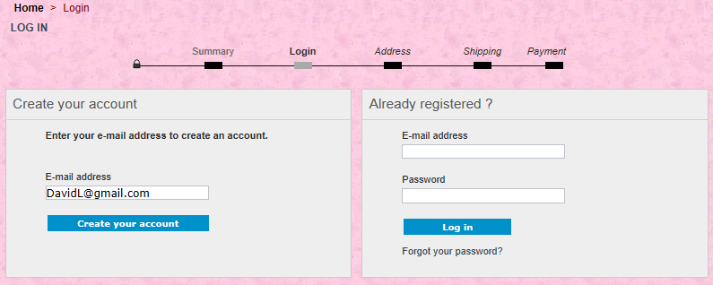
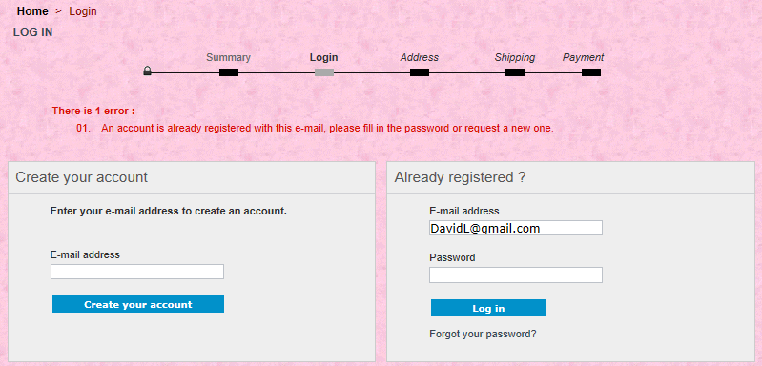
Which is the Candidate key?
Every Email
must be
unique

Slide 21

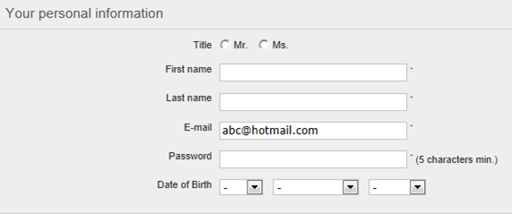
Which is the Candidate key?
Candidate key
Title | First_name | Last_name | Email | Password | DOB
Ms | Linda | See | LindaS@hotmail.com | Abc123 | NULL
Mr | David | Lee | DavidL@gmail.com | Da12lee | 13/09/1997
Ms | Linda | Soh | LSoh@hotmail.com | Abc123 | 20/12/1998
Customer
Email (an attribute) can uniquely identify a customer tuple (record) in the Customer relation

Slide 22

Which is the Candidate key?
Title | First_name | Last_name | Email | Password | DOB
Ms | Linda | See | LindaS@hotmail.com | Abc123 | NULL
Mr | David | Lee | DavidL@gmail.com | Da12lee | 13/09/1997
Ms | Linda | Soh | LSoh@hotmail.com | Abc123 | 20/12/1998
Title
First Name
Last Name
Email
Password
DOB
Customer
Yes | No

Slide 23

Which is the Candidate key?
Title | First_name | Last_name | Email | Password | DOB
Ms | Linda | See | LindaS@hotmail.com | Abc123 | NULL
Mr | David | Lee | DavidL@gmail.com | Da12lee | 13/09/1997
Ms | Linda | Soh | LSoh@hotmail.com | Abc123 | 20/12/1998
First Name
Last Name
Password
Customer
A minimal group of attributes
Identify the group of attributes which can
uniquely identify a customer based on the
tuples

Slide 24
Which is the Candidate key?
Title | First_name | Last_name | Email | Password | DOB
Ms | Linda | See | LindaS@hotmail.com | Abc123 | NULL
Mr | David | Lee | DavidL@gmail.com | Da12lee | 13/09/1997
Ms | Linda | Soh | LSoh@hotmail.com | Abc123 | 20/12/1998
Customer
There are tWO candidate keys
Of customer relation:
Single attribute email
Minimal group of attributes First name, last name, Password
Do we need so many identifiers
for a relation ?

Slide 25
Which is the Primary key?
Title | First_name | Last_name | Email | Password | DOB
Ms | Linda | See | LindaS@hotmail.com | Abc123 | NULL
Mr | David | Lee | DavidL@gmail.com | Da12lee | 13/09/1997
Ms | Linda | Soh | LSoh@hotmail.com | Abc123 | 20/12/1998
Customer
NO!!!
We do not need so many identifiers for a relation.
Choose one of the most suitable candidate key be the official identifier of a relation
Primary key

Slide 26

What is the Foreign key?
An attribute (column)
OR a group of attributes (2 or more columns) with a relation that matches
the value of the primary key OR the candidate key
of the home OR other relation

Slide 27
What is Foreign key ?
Title | First_name | Last_name | Email | Password | DOB
Ms | Linda | See | LindaS@hotmail.com | Abc123 | NULL
Mr | David | Lee | DavidL@gmail.com | Da12lee | 13/09/1997
Ms | Linda | Soh | LSoh@hotmail.com | Abc123 | 20/12/1998
Email
Primary key
Customer
Email | Product_code | Cart_ID | Qty
DavidL@gmail.com | HG4872 | C1001 | 1
DavidL@gmail.com | HG5879 | C1001 | 1
Foreign key
Cart
Email of cart relation
Is the foreign key referencing
The primary key in the customer relation

Slide 28
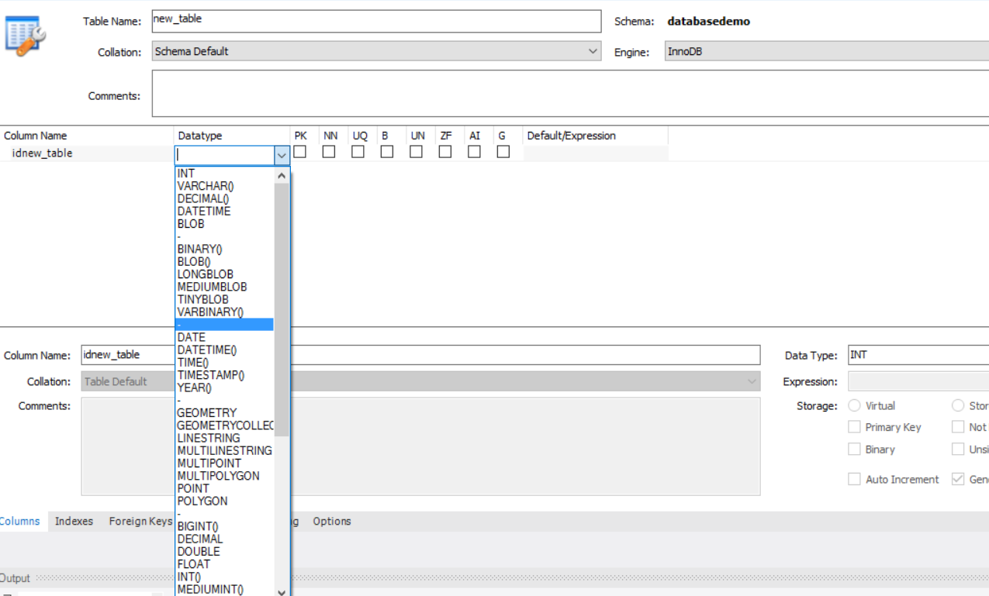
Data Types in mysql

Slide 29
Some common attribute data types
Integer
unsigned short => 0 to 65535
Smallint
Whole numbers (-32767 to 32767)
Decimal(m,n)
Char(n)
Varchar(n)
Date (replace Datetime in the textbook)
Date format
signed short => –32768 to 32767
unsigned long => 0 to 4294967295
signed long => –2147483648 to 2147483647
999.99 = Decimal(5,2)

Slide 30

What is a Database?
Cart
Data
Customer Data
Address Data
A collection of inter-related data

Slide 31
What is a Relational Database?
Customer
Cart
Title | First_name | Last_name | Email | Password | DOB
Ms | Linda | See | LindaS@hotmail.com | Abc123 | NULL
Mr | David | Lee | DavidL@gmail.com | Da12lee | 13/09/1997
Ms | Linda | Soh | Lsoh@hotmail.com | Abc123 | 20/12/1998
Email | Product_code | Cart_ID | Qty
DavidL@gmail.com | HG4872 | C10001 | 1
DavidL@gmail.com | HG5879 | C10002 | 1
DavidL@Gmail.com
DavidL@Gmail.com
* Normalized
A collection of inter-related proper form relations

Slide 32
SQL

Slide 33

What is SQL?

Slide 34
SQL
Structured Query Language
Pronounced as Sequel
Computing Language
- To communicate with DBMS to store, manipulate and retrieve data in database
- Create and manage databases
Standard Language for a relational database

Slide 35
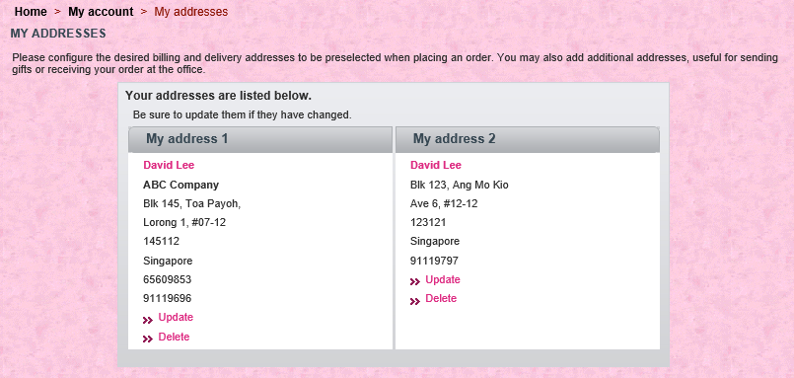
Web App Scenerio
Lets consider a web app whereby you have to maintain user basic profile info and his/her delivery address:

Slide 36
How to create customer profile table using SQL?
Title | First_name | Last_name | Email | Password | DOB
Ms | Linda | See | LindaS@hotmail.com | Abc123 | NULL
Mr | David | Lee | DavidL@gmail.com | Da12lee | 13/09/1997
Ms | Linda | Soh | LSoh@hotmail.com | Abc123 | 20/12/1998

Slide 37
How to create the customer profile table?
Customer
Column name | Data Type | Null Constraint
Title | Char(2) | NOT NULL
First_name | Varchar(20) | NOT NULL
Last_name | Varchar(20) | NOT NULL
Email (PK) | Varchar(50) | NOT NULL
Password | Char(8) | NOT NULL
DOB | Date | NULL
Syntax | Question
CREATE TABLE | What do you want to do?
<Table name> | What is the name?
(<column definition List>) | What are the attributes to create?
PRIMARY KEY (<column name list>) | Which is the primary key?
SQL commands
CREATE TABLE CUSTOMER
(TITLE CHAR(2) NOT NULL,
FIRST_NAME VARCHAR(20) NOT NULL,
LAST_NAME VARCHAR(20) NOT NULL,
EMAIL VARCHAR(50) NOT NULL,
PASSWORD CHAR(8) NOT NULL,
DOB DATE NULL,
PRIMARY KEY (EMAIL))

Slide 38
How to create the address table?
Address_ID | Address1 | Address2 | Email | Country | Pcode
My address 1 | Blk 145, Toa Payoh, | Lorong 1, #07-12 | DavidL@gmail.com | Singapore | 145112
My address 2 | Blk 123, Ang Mo Kio | Ave 6, #12-12 | DavidL@gmail.com | Singapore | 123121
Addr1 | 123 Flora Road | Garden Way | LSoh@hotmail.com | Singapore | 503984
A1 | 22 Lin Hua Road | NULL | LindaS@hotmail.com | China | 345982

Slide 39
How to delete a Table?
Syntax | Question
DROP TABLE | What do you want to do?
<Table name> | What is the name?
SQL commands
DROP TABLE CUSTOMER

Slide 40
SQL
Query

Slide 41
Address relation

Slide 42
How to retrieve all the data from a Table?
Syntax | Question
Select | What do you want to do?
ColumnName1, [,ColumnName2 = ColumnValue2…] | What columns do you want to select?
from <table> | What is the table name?
[WHERE row selection criteria] | What is the condition?
The [] indicates that the portion of the statement is optional and ‘…’ indicates that
there maybe more such pairs of ‘ColumnName = ColumnValue’.
Use * to select all columns

Slide 43
Removing Duplicates : DISTINCT
Address_ID | Address1 | Address2 | Email | Country | Pcode
My address 1 | Blk 145, Toa Payoh, | Lorong 1, #07-12 | DavidL@gmail.com | Singapore | 145112
My address 2 | Blk 123, Ang Mo Kio | Ave 6, #12-12 | DavidL@gmail.com | Singapore | 123121
Addr1 | 123 Flora Road | Garden Way | LSoh@hotmail.com | Singapore | 503984
A1 | 22 Lin Hua Road | NULL | LindaS@hotmail.com | China | 345982
Address
Country
Singapore
Singapore
Singapore
China
SELECT Country FROM Address
What are the countries of the customers?
Resulting Table

Slide 44
Removing Duplicates : DISTINCT
Address_ID | Address1 | Address2 | Email | Country | Pcode
My address 1 | Blk 145, Toa Payoh, | Lorong 1, #07-12 | DavidL@gmail.com | Singapore | 145112
My address 2 | Blk 123, Ang Mo Kio | Ave 6, #12-12 | DavidL@gmail.com | Singapore | 123121
Addr1 | 123 Flora Road | Garden Way | LSoh@hotmail.com | Singapore | 503984
A1 | 22 Lin Hua Road | NULL | LindaS@hotmail.com | China | 345982
A | 18 Huat Road | NULL | magS@hotmail.com | Malaysia | 234562
Address
Country
Singapore
China
Malaysia
SELECT DISTINCT Country FROM Address
What are the countries of the customers? I only want the country to display once.
Resulting Table

Slide 45
Sorting Resulting (Single Column Sorting)
Country
Canada
China
Japan
Korea
Malaysia
Singapore
Thailand
USA
SELECT *
FROM Country
ORDER BY Country ASC
Sort the results
In Ascending order
Resulting Table
Display the country in the Country table in ascending order.

Slide 46
Sorting Resulting (Single Column Sorting)
Country
Canada
China
Japan
Korea
Malaysia
Singapore
Thailand
USA
Country
Canada
China
Japan
Korea
Malaysia
Singapore
Thailand
USA
SELECT *
FROM Country
ORDER BY Country ASC
Resulting Table
Keyword ASC is OPTIONAL

Slide 47
Sorting Resulting (Single Column Sorting)
Address_ID | Address1 | Address2 | Email | Country | Pcode
My address 1 | Blk 145, Toa Payoh, | Lorong 1, #07-12 | DavidL@gmail.com | Singapore | 145112
My address 2 | Blk 123, Ang Mo Kio | Ave 6, #12-12 | DavidL@gmail.com | Singapore | 123121
Addr1 | 123 Flora Road | Garden Way | LSoh@hotmail.com | Singapore | 503984
A1 | 22 Lin Hua Road | NULL | LindaS@hotmail.com | China | 345982
A | 18 Huat Road | NULL | magS@hotmail.com | Malaysia | 234562
Resulting Table
First list the email in descending order. Then, list the country in ascending order

Slide 48
Limiting Rows
Country
Canada
China
Japan
SELECT *
FROM Country
ORDER BY Country ASC
LIMIT 3
Limit the records to only the top 3

Slide 49
SQL
Database Updates

Slide 50
Insert
INSERT INTO <tablename> (<field list>) VALUES (<valuelist>)
SQL | Syntax | Question
INSERT INTO | INSERT INTO | What do you want to do?
TableName(Column1 …, column N) | <Table> (field list) | Which columns do you want to insert?
Values(column1,…,column N) | Actical values 1….n | What is the actual value?

Slide 51
Update
Syntax | Question
UPDATE | What do you want to do?
<Table> | What do you want to update?
SET ColumnName1 = ColumnValue1 [,ColumnName2 = ColumnValue2…] | What are the changes?
[WHERE row selection criteria] | What is the condition?
The [] indicates that the portion of the statement is optional and ‘…’ indicates that
there maybe more such pairs of ‘ColumnName = ColumnValue’.

Slide 52
Delete Specific Rows
SQL | Syntax | Question
DELETE FROM | DELETE FROM | What do you want to do?
address | <Table> | What do you want to delete?
[WHERE row selection criteria] | [WHERE row selection criteria] | What is the condition?

Slide 53
SQL
Table Joins

Slide 54
JOIN Operation
List all the delivery Postal code address for each user
Title | First_name | Last_name | Email | Password | DOB
Ms | Linda | See | LindaS@hotmail.com | Abc123 | NULL
Mr | David | Lee | DavidL@gmail.com | Da12lee | 13/09/1997
Ms | Linda | Soh | LSoh@hotmail.com | Abc123 | 20/12/1998
Address_ID | Address1 | Address2 | Email | Country | Pcode
My address 1 | Blk 145, Toa Payoh, | Lorong 1, #07-12 | DavidL@gmail.com | Singapore | 145112
My address 2 | Blk 123, Ang Mo Kio | Ave 6, #12-12 | DavidL@gmail.com | Singapore | 123121
Addr1 | 123 Flora Road | Garden Way | LSoh@hotmail.com | Singapore | 503984
A1 | 22 Lin Hua Road | NULL | LindaS@hotmail.com | China | 345982

Slide 55
JOIN Operation
First_name | Last_name | Email
Linda | See | LindaS@hotmail.com
David | Lee | DavidL@gmail.com
Linda | Soh | LSoh@hotmail.com
Email | Pcode
DavidL@gmail.com | 145112
DavidL@gmail.com | 123121
LSoh@hotmail.com | 503984
LindaS@hotmail.com | 345982
SQL
SELECT Customer.FirstName,Customer.LastName, Customer.email,Address.PCode
FROM Customer, Address
WHERE Customer.Email=Address.Email;
First_name | Last_name | Email | PCode
Linda | See | LindaS@hotmail.com | 345982
David | Lee | DavidL@gmail.com | 145112
David | Lee | DavidL@gmail.com | 123121
Linda | Soh | LSoh@hotmail.com | 503984
Resulting Table

Slide 56
JOIN Operation - Use Table Alias as Shortcuts
First_name | Last_name | Email
Linda | See | LindaS@hotmail.com
David | Lee | DavidL@gmail.com
Linda | Soh | LSoh@hotmail.com
Email | Pcode
DavidL@gmail.com | 145112
DavidL@gmail.com | 123121
LSoh@hotmail.com | 503984
LindaS@hotmail.com | 345982
SQL
SELECT c.FirstName,c.LastName, c.email,a.PCode
FROM Customer c, Address a
WHERE c.Email=a.Email;
First_name | Last_name | Email | PCode
Linda | See | LindaS@hotmail.com | 345982
David | Lee | DavidL@gmail.com | 145112
David | Lee | DavidL@gmail.com | 123121
Linda | Soh | LSoh@hotmail.com | 503984
Resulting Table

Slide 57
The End

